Slide 1
Poe: Process of elimination for multiple choice reasoning
University of Electronics Science and Technology of China
University of Texas at Dallas
Dongzhuyuan Lu
Chenkai Ma and Xinya Du. PoE: Process of elimination for multiple choice reasoning. In EMNLP, 2023. URL https://aclanthology.org/2023.emnlp-main.273.pdf

Slide 2
overview
Inspired by the way human beings do MCQs, the paper presents Process of Elimination (PoE), a two-step scoring method.
In the first step, PoE scores each option, and eliminates seemingly wrong option. In the second step, PoE masks these wrong options, and makes the final prediction.
Zero-shot experiments on 9 reasoning tasks illustrate the effectiveness of PoE, especially on logical reasoning tasks.

Slide 3
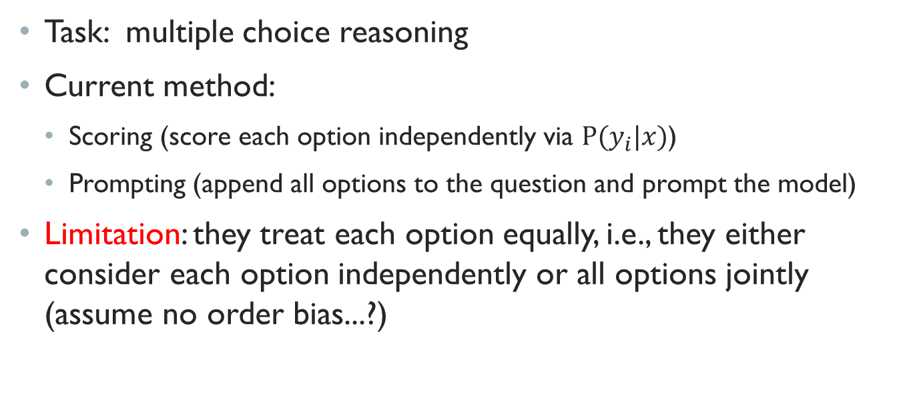
Background
Task: multiple choice reasoning
Current method:
Scoring (score each option independently via $P(y_{i}|x)$)
Prompting (append all options to the question and prompt the model)
Limitation: they treat each option equally, i.e., they either consider each option independently or all options jointly (assume no order bias...?)

Slide 4
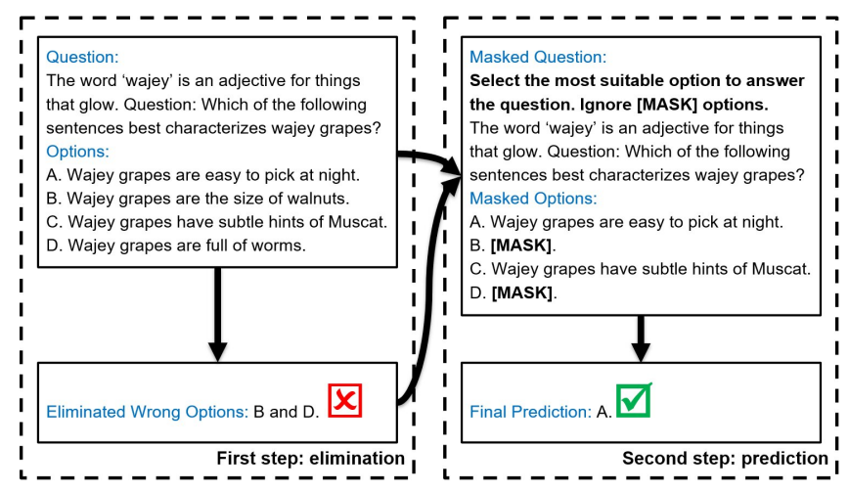
Method: Process of elimination

Slide 5
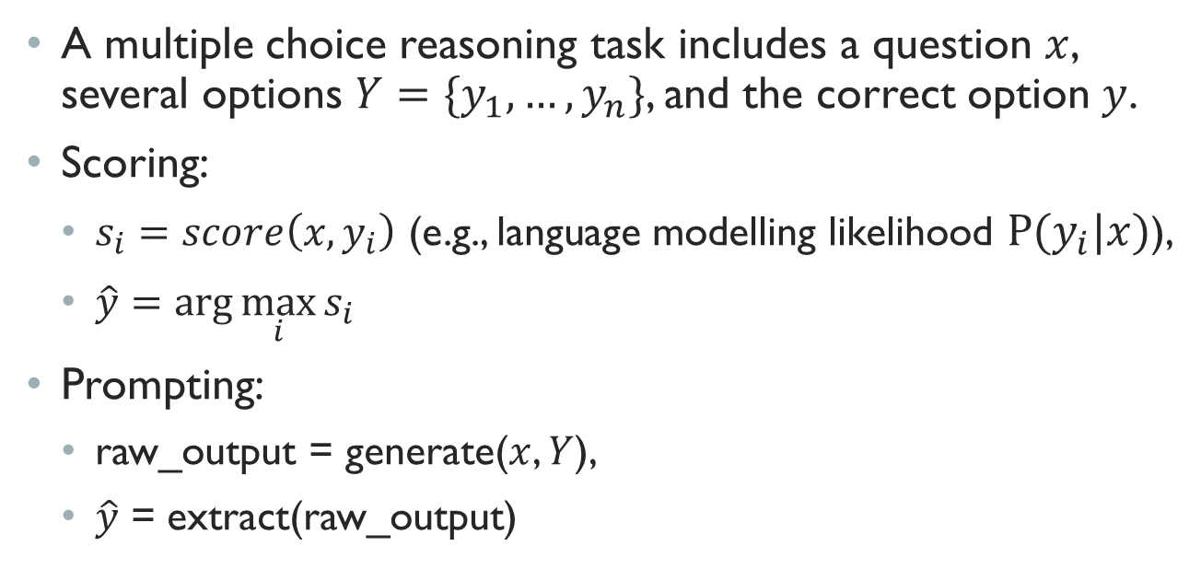
Problem setting
A multiple choice reasoning task includes a question $x$, several options $Y=\{y_{1},…,y_{n}\}$, and the correct option $y$.
Scoring:
$s_{i}=score\left(x, y_{i}\right)$ (e.g., language modelling likelihood $P(y_{i}|x)$),
$\hat{y}=\arg{\max_{i}{s_{i}}}$
Prompting:
raw_output = generate($x$, $Y$),
$\hat{y}$ = extract(raw_output)

Slide 6
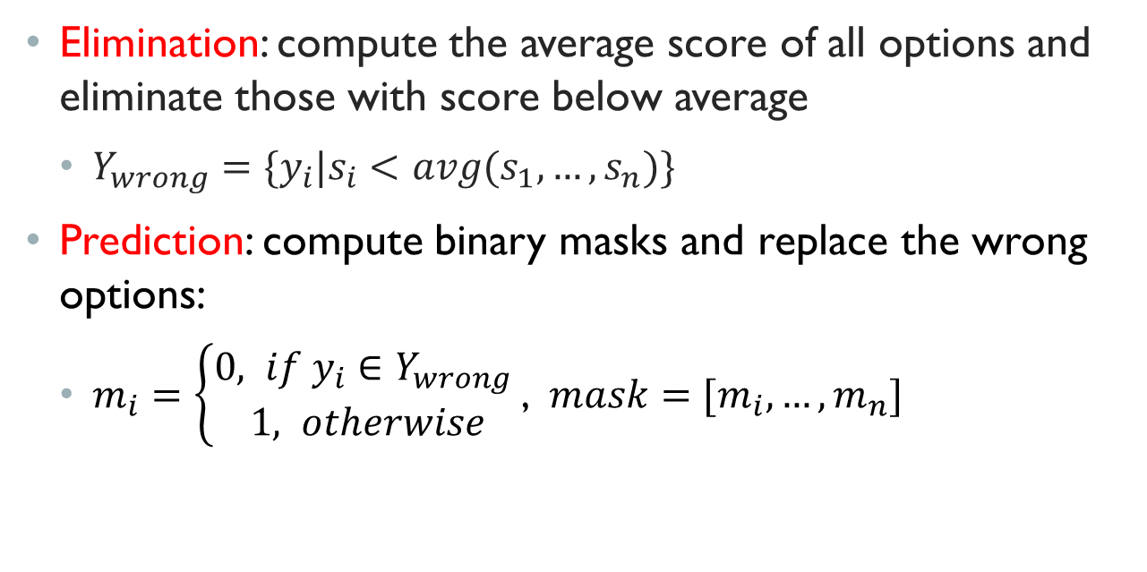
poe
Elimination: compute the average score of all options and eliminate those with score below average
$Y_{wrong}=\{y_{i}|s_{i}<avg(s_{1},…, s_{n})\}$
Prediction: compute binary masks and replace the wrong options:
$m_{i}=\left\{\begin{aligned}0, if y_{i}∈Y_{wrong} \\ 1, otherwise\end{aligned}\right.$, $mask=[m_{i},…,m_{n}]$

Slide 7

POE
Prediction: create a template T to mask out wrong options
$x_{mask}=T(x, Y, mask)$

Slide 8
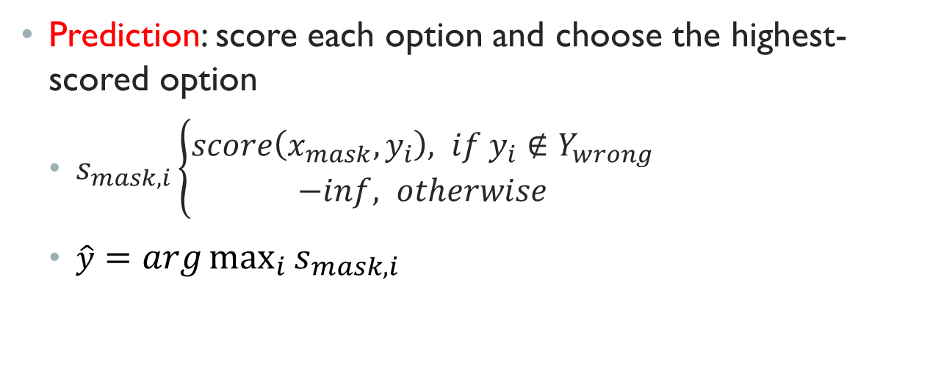
POE
Prediction: score each option and choose the highest-scored option
$s_{mask,i}\left\{\begin{aligned}score\left(x_{mask}, y_{i}\right), if y_{i}∉Y_{wrong} \\ −inf, otherwise\end{aligned}\right.$
$\hat{y}=arg\max_{i}{s_{mask,i}}$

Slide 9
Experiment setup
Data: the paper considers 8 multiple choice reasoning, including ANLI, CQA, SIQA, BIG-bench tasks (BIG-BENCH Hard: LD, DQA, CC, SS, SIT) and sample 100 instances from each task
Models: FLAN-T5-XL (5B)
Baselines: language modeling, average language modeling, calibration, and multiple choice prompting (MCP). For PoE, they use MCP in both steps.

Slide 10
Setting
Evaluation: zero-shot
Metric: accuracy

Slide 11
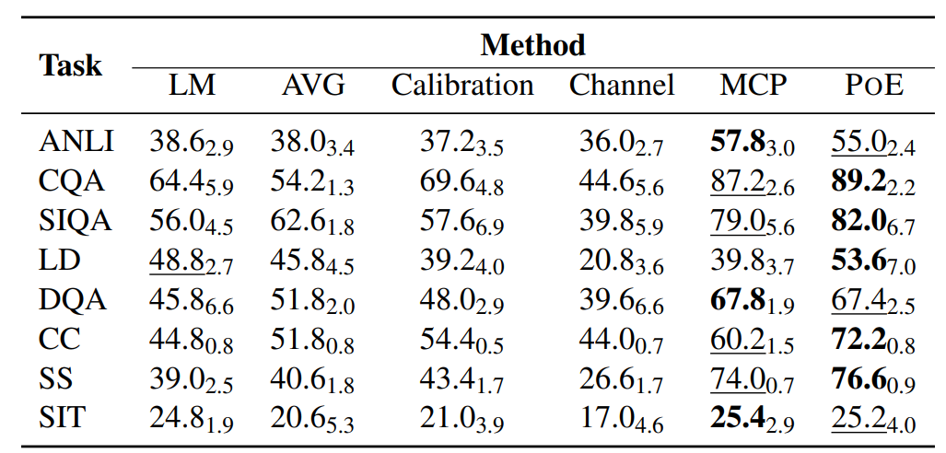
Results

Slide 12
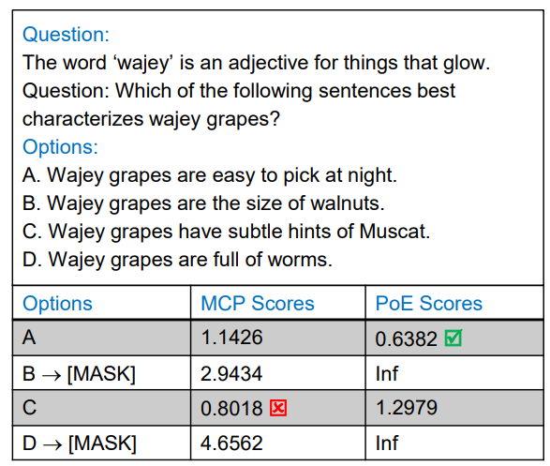
observation
1. PoE beats MCP on 5 tasks
2. PoE is exceptionally performant on CC (an example below)

Slide 13
Observation
The work finds out that PoE performs better on LD and CC which are logical reasoning tasks.
Hypothesis: PoE performs better on tasks requiring logical reasoning.
Verification: conduct experiments on more logical reasoning tasks.

Slide 14
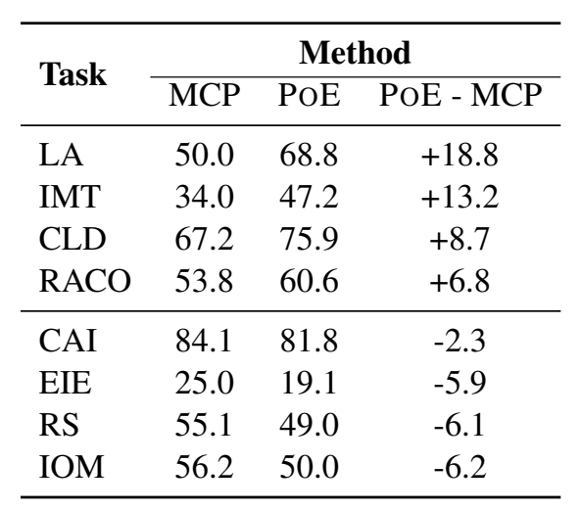
Results: logical reasoning
logical reasoning
commonsense or social reasoning

Slide 15
Conclusion
The work presents a two-step scoring method for multiple choice reasoning.
The method performs well on zero-shot setting on logical reasoning.
PoE also works with LLMs or in the few-shot setting.

